Slide 1
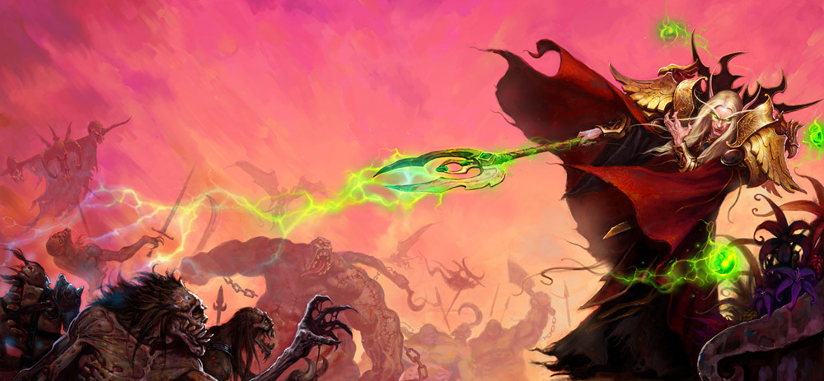
GA 4401 – Advanced Game Prototyping
Week 6
End-to-End gameplay, approaching big problems

Slide 2
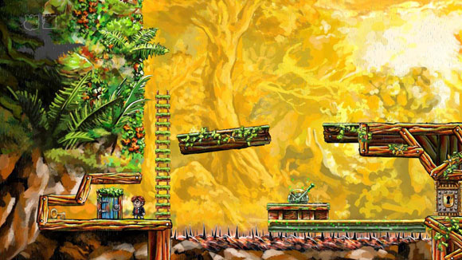
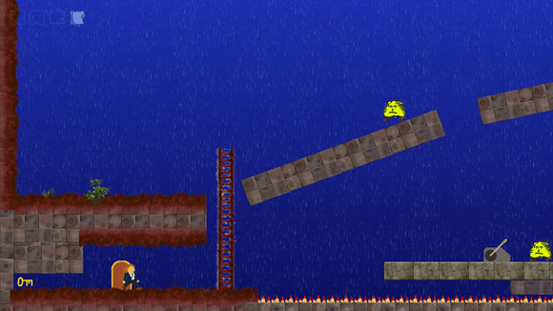
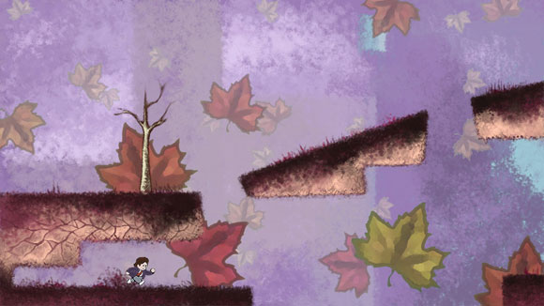

Prototyping vs Production Quantity vs Quality
http://www.gamasutra.com/view/feature/132147/the_art_of_braid_creating_a_.php?print=1

Slide 3
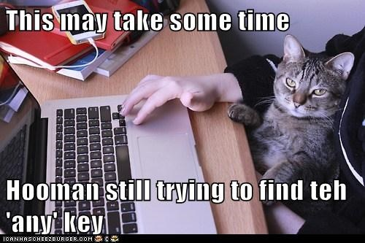
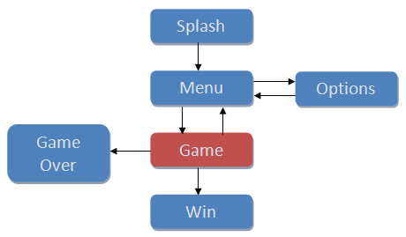
End-to-end
Notes:
Menu
Gameplay
Win
Loss
Audio
Graphics

Slide 4
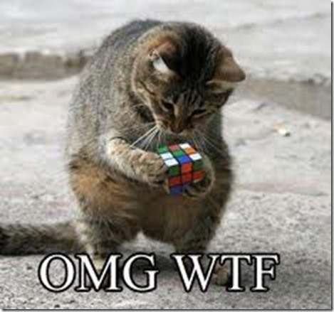
Approaching a complex problem
Common mistakes
Notes:
Most common mistake – trying to immediately work on the prototype without understanding the goal first
Another mistake is trying to solve or implement too much on the first iteration
Keep it simple!

Slide 5
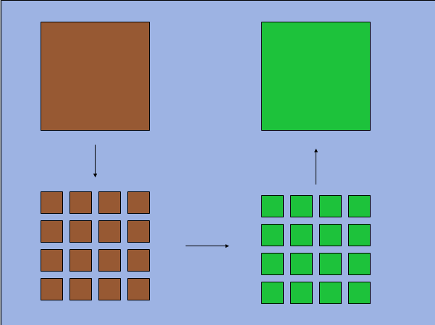
Game prototyping Breaking down the problem or goal
Notes:
How do you break your big problem down into little ones that can be protoyped?
Prototypes are best applied to small problems, where they can make quick traction. What about big problems?

Slide 6
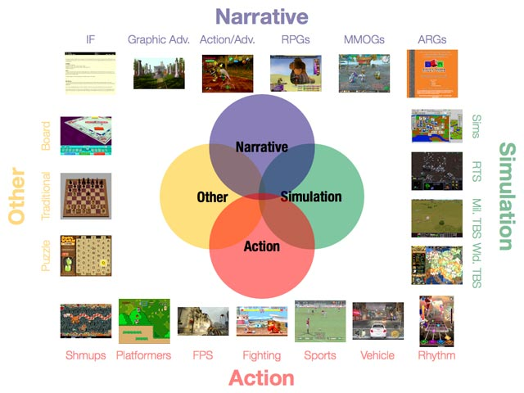
Prototyping based on game genres/types
Notes:
Action
Ball + Paddle, Beat-em-up, hack + slash, fighting, maze, pinball, platformer, shooter, FPS, mmo FPS, etc
Action-Adventure
stealth, horror, zelda, metroid, etc
Adventure
Text/graphic adventures, monkey island, day of the tentacle
RPG
Simulation
Simcity, sims, Flight sim, vehicle sims
Strategy
RTS, ARTS, Tower defense, turn based strategy (fire emblem, advance wars), Civilization
Music/Party/Arcade/Programming/Trivia/Board/Sports
Video games by purpose
Casual, Adult, Educational, Serious games

Slide 7
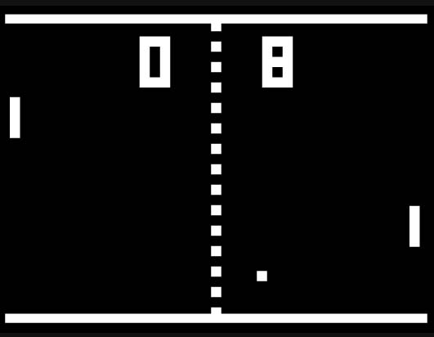


Group work - practice breaking down problems
Design a paid MMORPG that can beat World of Warcraft in subscribers.
Take pong and bring it up to modern standards.
Redesign League of Legends to be a different genre.
Puzzle
Shooter

Slide 8
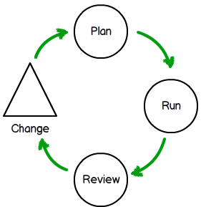
Iterative Game Design
1. Prototype
Make a prototype rapidly
2. Playtest
Partial or full
3. Revise
Fortify weaknesses and build on strengths
4. Repeat
Go back to the prototype and start the next iteration
Notes:
Determine gameplay
Determine visual style (hopefully aids gameplay)
Determine flow of the game (win/loss conditions, menus, etc)
Create/Edit gameplay
Add/Refine Assets
Test and repeat
Polishing the rest
What does tuning mean, and why is it important?

Slide 9
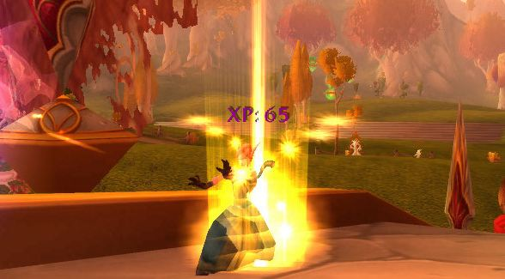
How to improve at prototyping?
Practice!
Game Jams
Ludum Dares
Notes:
Practice
Ludum Dare

Slide 10

Voting time!
Tiny World
Exploration
Evolution
Survival
Minimalism
Death Is A New Beginning
Kittens
Artificial Life
Alchemy
One Room
Castles In The Sky
Indirect Control
Randomly Generated
Growth
Limited Resources
Discovery
Parallel Universes
Alternate Reality
Explore The Universe
Castles

Slide 11
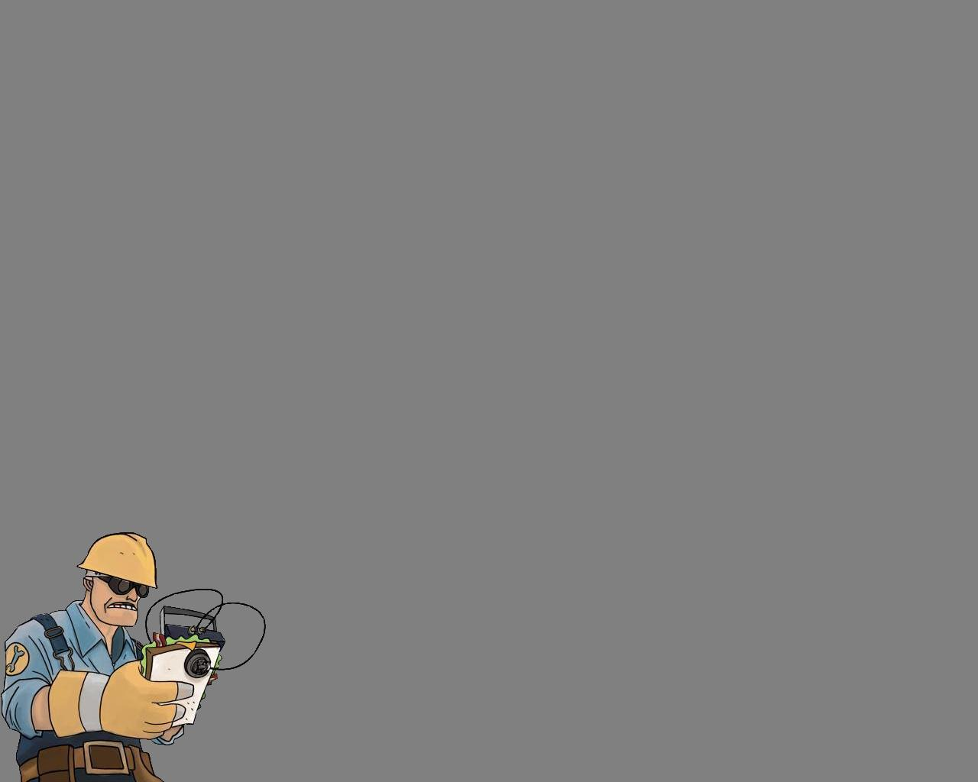
Results + Lab!

